Slide 1
The Power of the Dashboard
Created by Ravi Chinnamanaidu and Allana Nelson

Slide 2
Table Of Content
Overview
Understanding the problems
Large Language Model (LLM)
Hugging Face Image Captioning
Additional Questions
Results and Conclusion
Audience Questions

Slide 3
Overview
Developed a Large Language Model (“LLM”) dashboard, which integrated to various API providers including OpenAPI, text description, PDF Loader, Wikipedia, NASA.gov, prompt templates and image captioning.
We completed this integration by using:
GPT-2, LangChain, Hugging Face, Pytorch, OpenAI, Transformers and Image Processing
Notes:
https://huggingface.co/bipin/image-caption-generator

Slide 4
Understanding the problems
01
How can we create a dashboard that can help people from various backgrounds and professions with inquiries they may have throughout the day?
02
How can we help people create relatable captions for their social media?
03
The data is from hugging face that has the csv/excel built-in that loads the encoder model and image processor

Slide 5
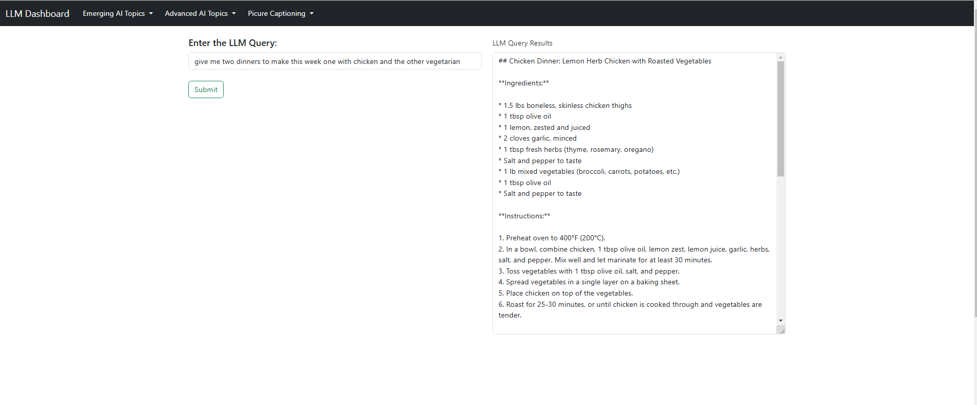
LLM Food Recipe

Slide 6
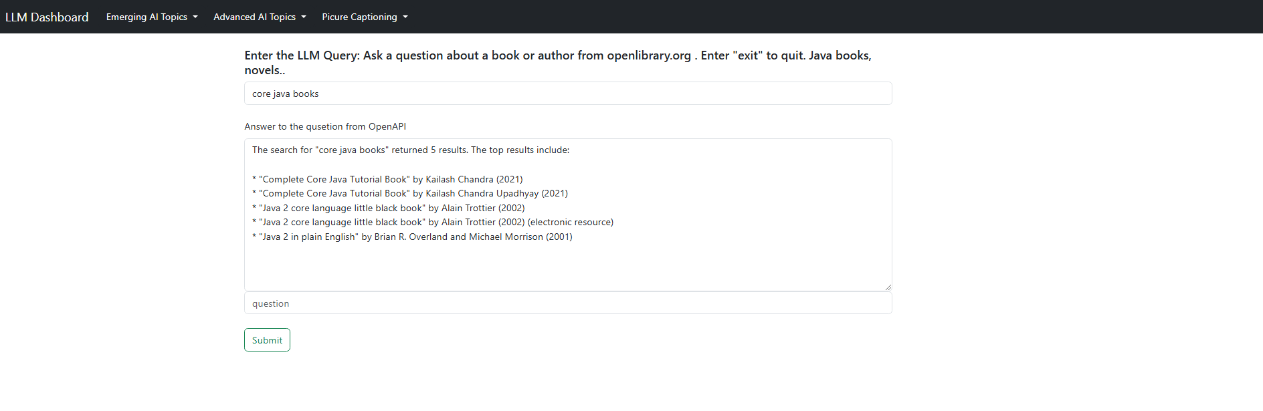



LLM OpenLibrary Org

Slide 7
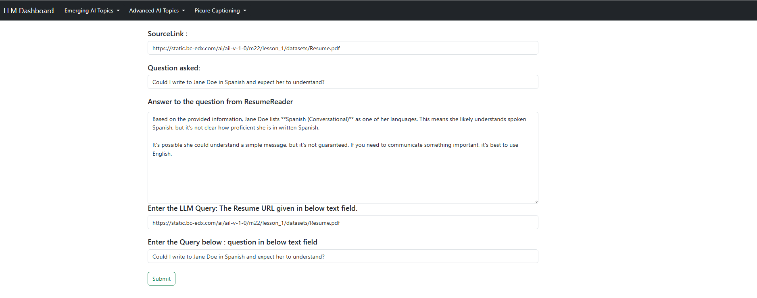
LLM Resume Reader

Slide 8
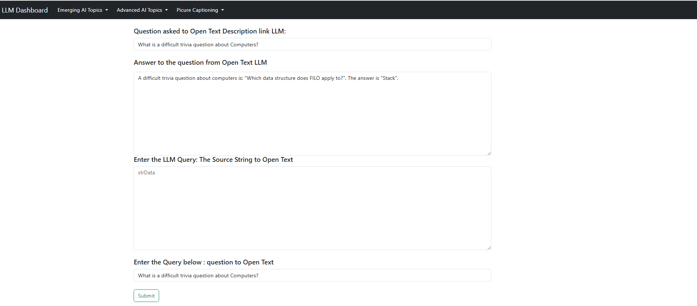
LLM Open Text Description Database

Slide 9
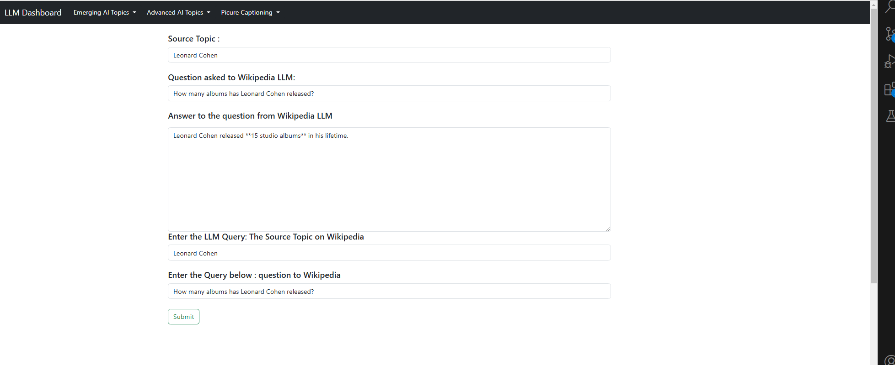
LLM Wikipedia Query

Slide 10
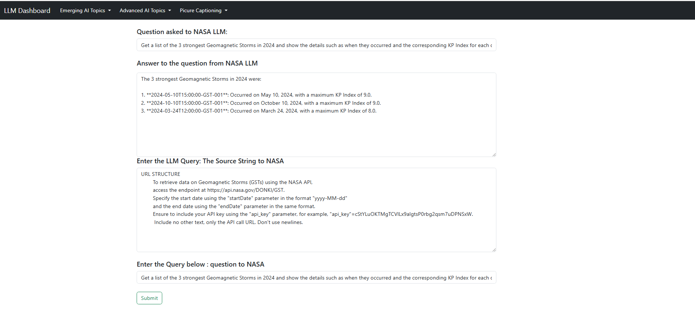
LLM NASA Query

Slide 11


LLM Prompt Template
Showcase dashboard - Live Demonstration

Slide 12
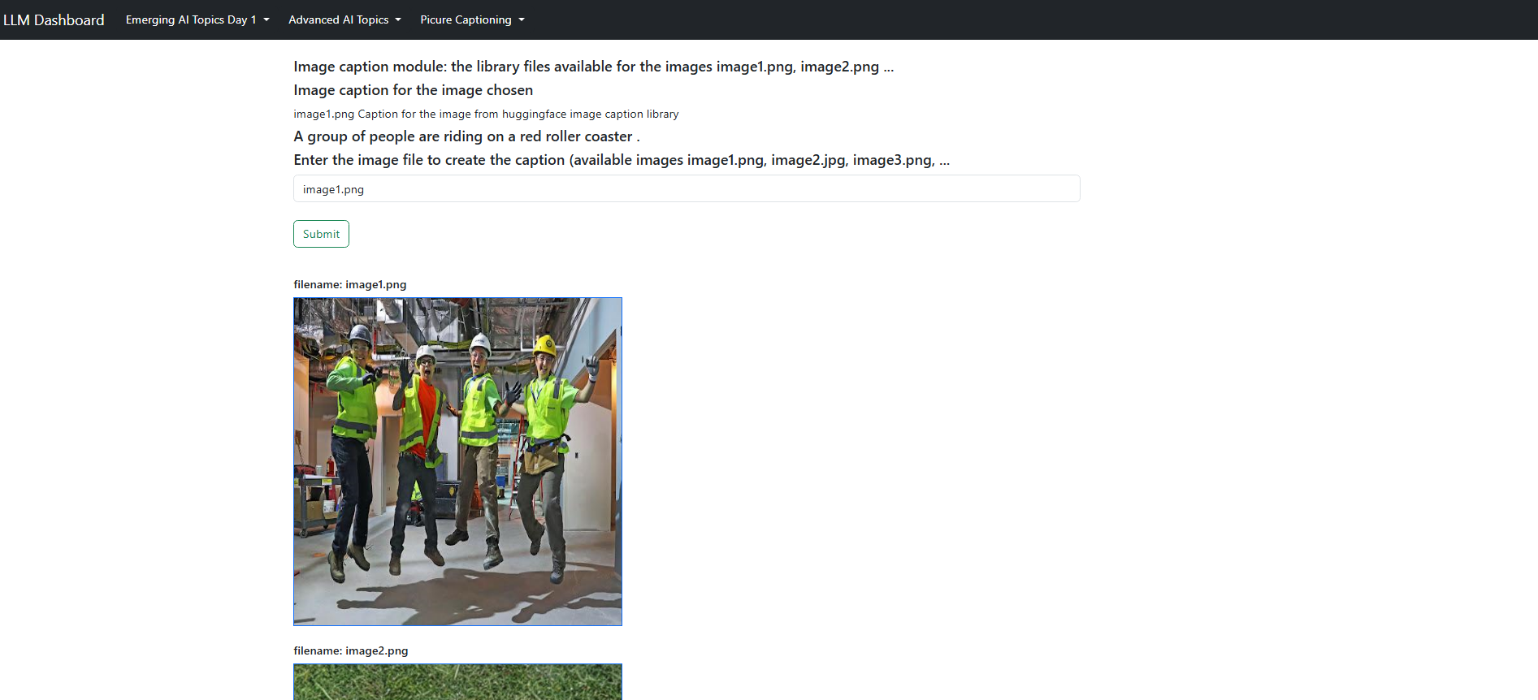
Hugging Face Image Caption
Showcase dashboard - Live Demonstration

Slide 13
Conclusions
01
Some of the transactions are taking more time to train the model during runtime and provide the answers for the query, more code optimizations are required to improve the performance.
02
The dashboard loading status needs to be provided after user enters the query and submits the form.
03
The image captioning can only provide captions based on specific objects in the images and assumptions made by those object. The image captioning does not factor in mood or desired tone of the user.
04
Further exploration in getting more concise responses to queries and captions that are more aligned to user preference.

Slide 14
Thank you!

